Slide 1
A trial of multiple neural networks reflecting the results of COVID-19 CT image processing
C.-H. Hsia,Professor, Department of Information Engineering, National Yilan University
CHI-JUNG HSIEH ,Bachelor student, Department of Information Engineering, National Yilan University
Tsai-Chu Wang ,Bachelor student, Department of Information Engineering, National Yilan University
Notes:
多種神經網路COVID-19 CT 影像處理反映結果的試驗

Slide 2
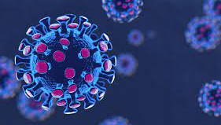
BACKGROUND
Notes:
先來介紹一下背景

Slide 3
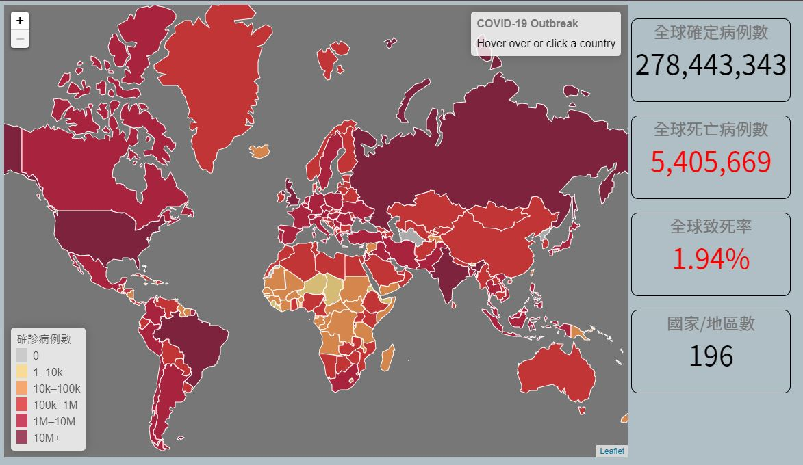
BACKGROUND
Severe Special Infectious Pneumonia (COVID-19) was first detected in People's Republic of China at the end of 2019, and then quickly spread to many countries around the world in early 2020, gradually turning into a global pandemic
Notes:
嚴重特殊傳染性肺炎疫情（COVID-19）在2019年末於中華人民共和國湖北省武漢市首次被發現，隨後在2020年初迅速擴散至全球多國，逐漸變成一場全球性大瘟疫。截至2021/12全球已有2億7千萬名感染者，死亡病例數540多萬人，全球致死率1.94%
數據來自:https://sites.google.com/cdc.gov.tw/2019ncov/global

Slide 4
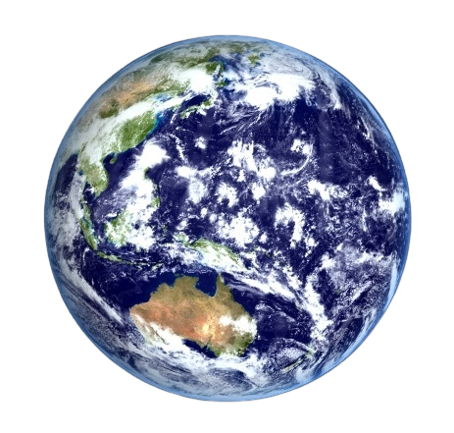
Effection of COVID-19
COVID-19
Highly contagious
Low lethality
COVID-19 has two characteristics: high infection rate and low fatality rate
This has led to its rapid global spread
Notes:
COVID-19有兩個特點:低致死率與高傳染率，這兩個條件可以在上述的數據看到，高傳染率讓他容易散播，低致死率讓他的宿主不容易死亡感染更多人，這讓它在全球迅速的傳播，對全球造成影響。

Slide 5

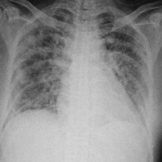
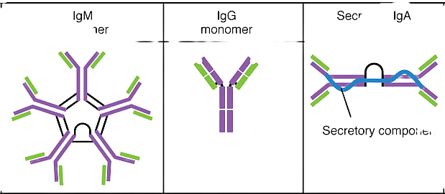
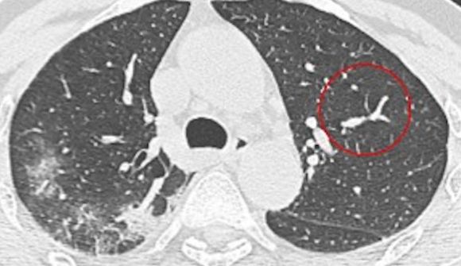



Ways to prevent Covid-19
Accodring to “國家衛生健康委員會,國家中醫藥管理局.新型冠狀病毒肺炎診療方案(試行第七版)”
RT-PCR
At present, the commonly used detection methods.
IgM
IgG
CT
Computer tomography.
Chest-X-Rays
Chest X-rays is a painless, non-invasive test
Etiology
Chest medical imaging
Serologic Test
Notes:
根據國家衛生健康委員會,國家中醫藥管理局.新型冠狀病毒肺炎診療方案(試行第七版)，COVID-19的檢查分成四種，除了一般檢查以外，還有下面這四種
病理學上的檢測:通常是XRT-PCR(逆轉錄聚合酶反映)也是我國目前最常見的檢測方式，通常是鼻咽或深喉PCR
血清學上的檢測:COVID-19在發病後3-5天出現IgM陽性反應，此時IgG低度反應大幅增長。
胸部影像學:有電腦斷層掃苗(CT)跟胸部X光照片兩種方式，因為COVID-19的患者常有肺泡腫脹的症狀，當肺泡破裂，組織液體跑出來會在照片中顯示白白的，稱為毛玻璃病灶，以此來判斷有無感染COVID-19。

Slide 6
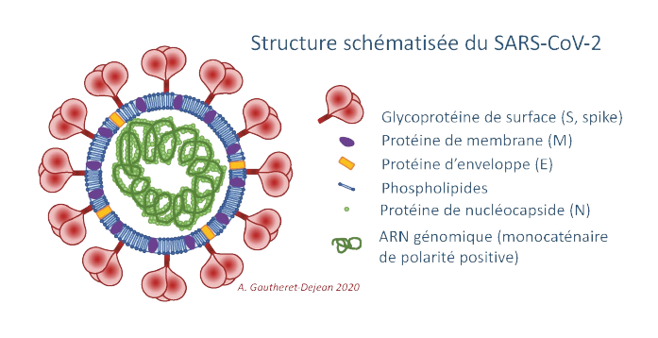
CT Image Machine Learning
Target:Analyze whether you are infected with COVID-19 through CT images of the lungs
During the outbreak, most viral pneumonias are caused by SARS-CoV-2
Notes:
我們所達成的特定醫學任務即是透過肺部CT影像分析是否有感染COVID-19，CT影像可用於判斷患者是否感染病毒性肺炎（COVID-19是一種由SARS-CoV-2病毒引起的病毒性肺炎）。但是CT 無法確定導致病毒性肺炎的病毒是 SARS-CoV-2 還是其他病毒。
嚴格來說，CT 不能用於確認患者是否感染了 COVID-19。 然而在疫情爆發期間，大多數病毒性肺炎是由 SARS-CoV-2 引起的。也就是說，如果患者根據CT結果確診為病毒性肺炎，這種病毒性肺炎極有可能是COVID-19。
由於這一事實，CT 被認為可用於在 COVID-19 爆發期間進行診斷。
ref:”COVID-CT-Dataset: A CT Image Dataset about COVID-19”

Slide 7
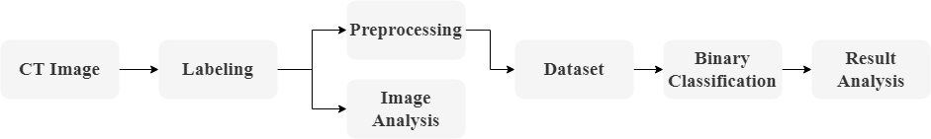
Motivation
The main concept comes from "Medical Image Processing and Deep Learning to Diagnose COVID-19 with CT Images"
For this task, after the professor’s suggestion, we finally considered the label of medical imaging, and chose a processing method that is relatively suitable for medical imaging at each step. Based on this idea, we build a method for processing images.
Notes:
主要概念來自《醫學圖像處理和深度學習以 CT 圖像診斷 COVID-19》
對於這個任務，經過教授的建議，我們最終考慮了醫學成像的標籤，在每一步都選擇了一種相對適合醫學成像的處理方法。 基於這個想法，我們構建了一種處理圖像的方法。
下圖是我們的流程

Slide 8

DATASET
Notes:
下面說明一下我們的資料集

Slide 9
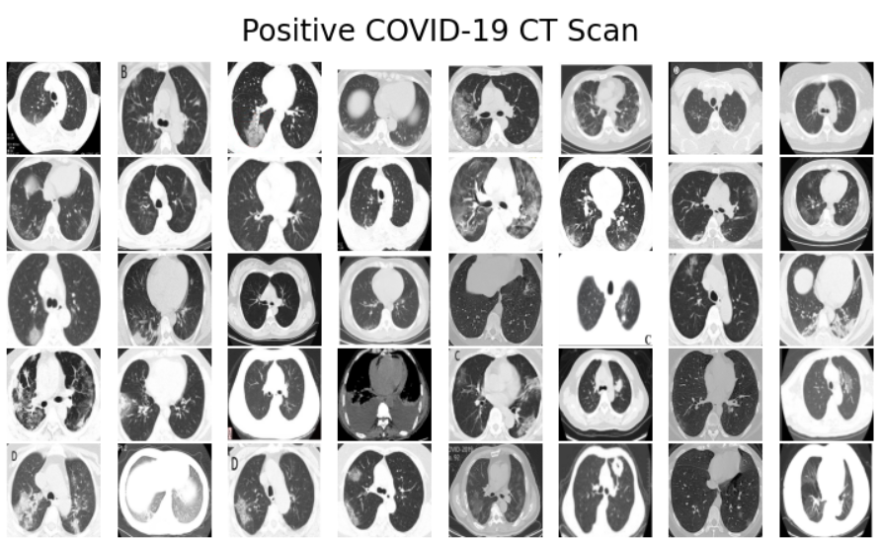
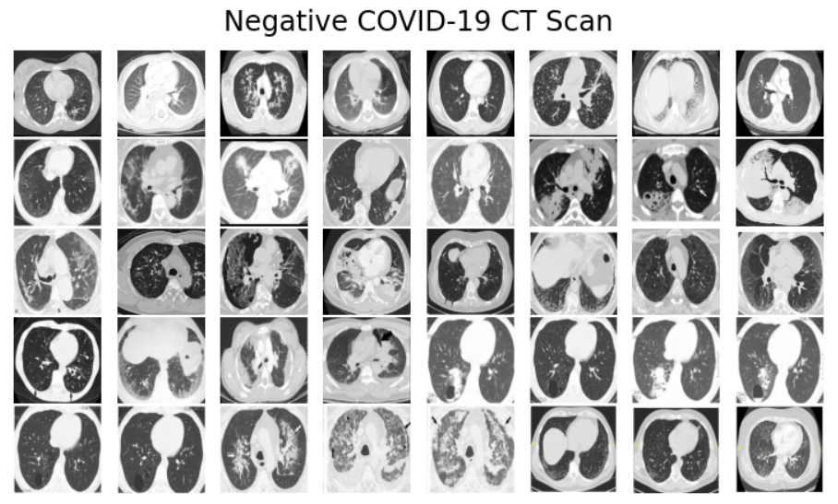
Source
Regarding the COVID-19 CT data set, there are open source data on the Internet. Here we use the open source data set from Github. The usefulness of this data set has been confirmed by a senior radiologist at Tongji Hospital in Wuhan, China, who diagnosed and treated a large number of COVID-19 patients during the outbreak of the disease from January to April.
Notes:
關於COVID-19 CT資料集，網路上已有開源的資料，這邊我們使用來自Github上的開源資料集[11]。該數據集的實用性已得到中國武漢同濟醫院的一名高級放射科醫生的證實，他在 1 月至 4 月間該疾病爆發時期對大量 COVID-19 患者進行了診斷和治療。

Slide 10
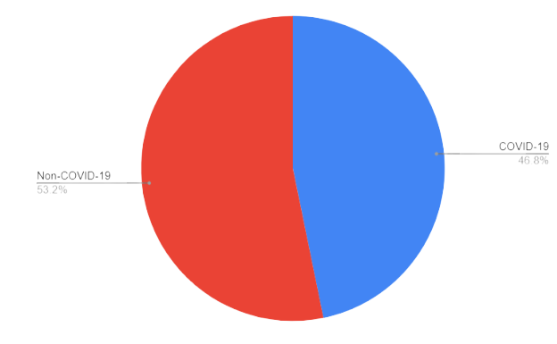
Dataset
This dataset contains 349 COVID-19 CT images and 397 Non-COVID-19 CT images, a total of 746
Dataset
Resize images
Scramble data
Train:Test=8(597):2(149)
Notes:
重整成224 x 224的大小
打亂資料
資料比為8:2

Slide 11

Preprocessing
Notes:
接下來介紹前處理的部分

Slide 12
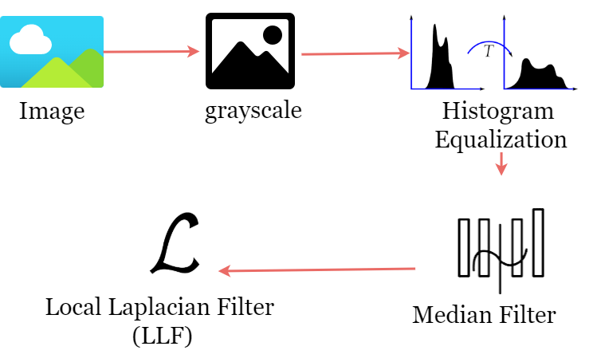
Process
Notes:
這是我們前處理的流程，接下來會一一介紹

Slide 13
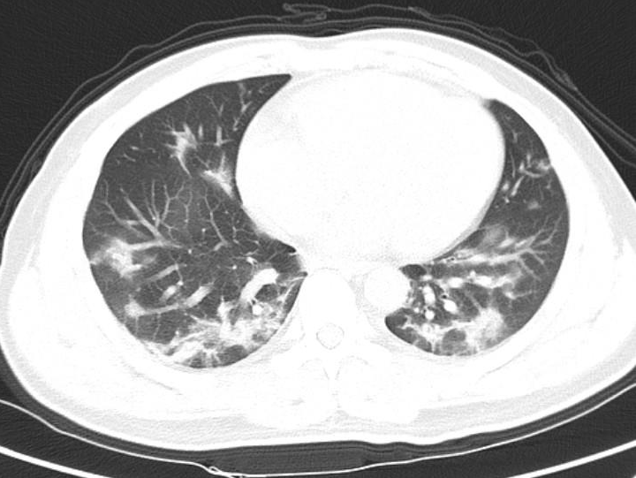

Binarization
The basic image segmentation method converts the grayscale value of each pixel (pixel), and finally transfers the grayscale image to a binary image.
In practice, we use OpenCV's cvtColor() function to convert the image between RGB/BGR and grayscale color space
Original image
Binarization image
Notes:
使用基本的圖像分割方法，將各像素(pixel)的灰階值轉化，最後由灰度圖像傳為二值圖像，也就是二值化處理。
實作上，我們使用OpenCV的cvtColor()函數將圖像在 RGB/BGR 和灰度之間進行顏色空間轉換

Slide 14

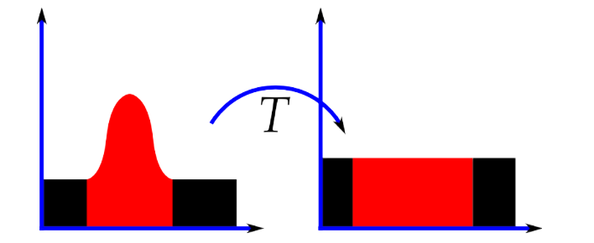
Histogram equalization
In practice, we use OpenCV's equalizeHist() for histogram equalization
Use image histogram to adjust contrast
Binarization image
Histogram equalization image
Notes:
第二個是直方圖等化，運用累積分布函數(CDF)對灰度值進行調整以實現對比度增強,把原始圖像的灰度直方圖從比較集中的某個灰度區間變成在全部灰度範圍內的均勻分佈。
實作上我們採用OpenCV的equalizeHist()進行直方圖等化

Slide 15
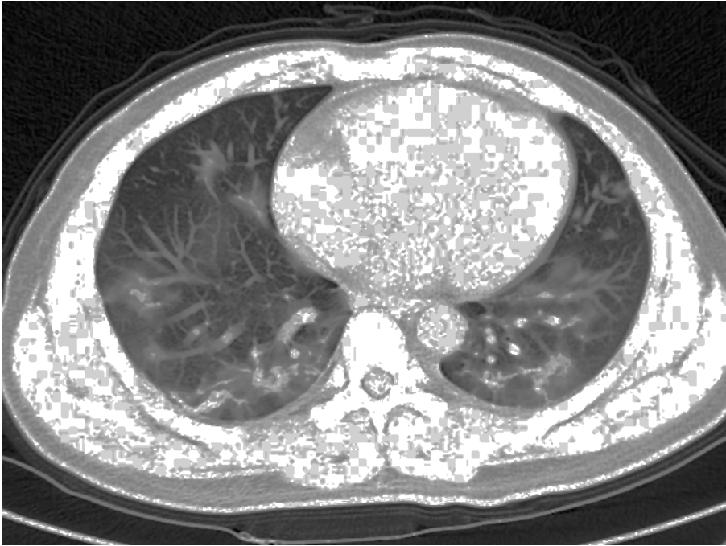
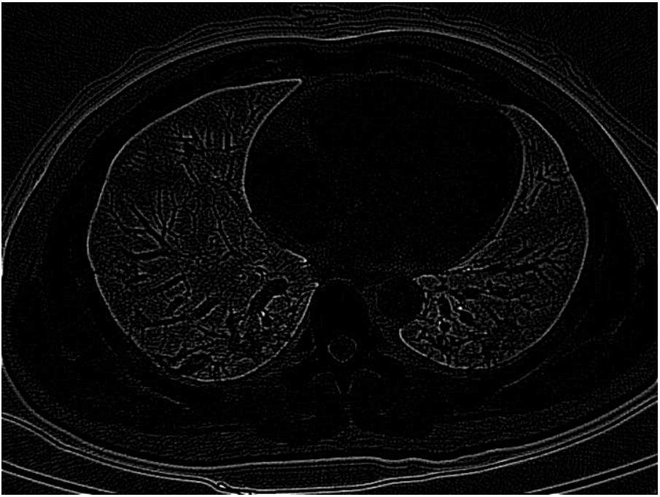
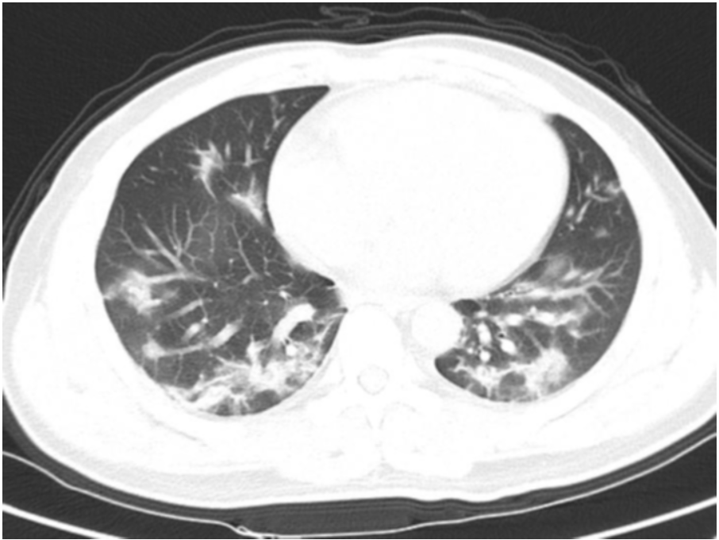
Median filter
Median filtering is actually used to filter out noise. Noise will interfere with the capture of image features, so it is very important to filter out noise.
Medium filter
Laplacian of Gaussian
Average_filter
Histogram equalization image
Medium filter
Notes:
第三個是中值濾波。濾波器有很多中，像均值濾波或拉普拉斯濾波，但因為中值濾波保留邊緣的特性，故我們使用中值濾波。
右上方的三張圖分別是中值濾波、高斯拉普拉斯濾波、及均值濾波處理同一張圖片後的比較。
實作上，我們採用OpenCV的medianBlur()，並將內核設為3，進行中值濾波。

Slide 16
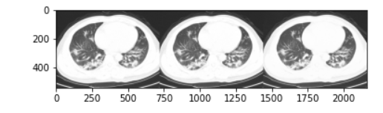
Local Laplacian filtering
Traverse all pixels in all Gaussian pyramid images, and recalculate an image with the same size as the original image from the original image and a certain mapping function according to the pixel value of each pixel
Notes:
最後一個前處理是局部拉普拉斯濾波，這個濾波方法是基於拉普拉斯濾波，但比拉普拉斯增加了簡單性和靈活性，不需要優化或後處理，也不會降低邊緣強度。
實作上我們使用github上的模型為參考，進行實作。

Slide 17
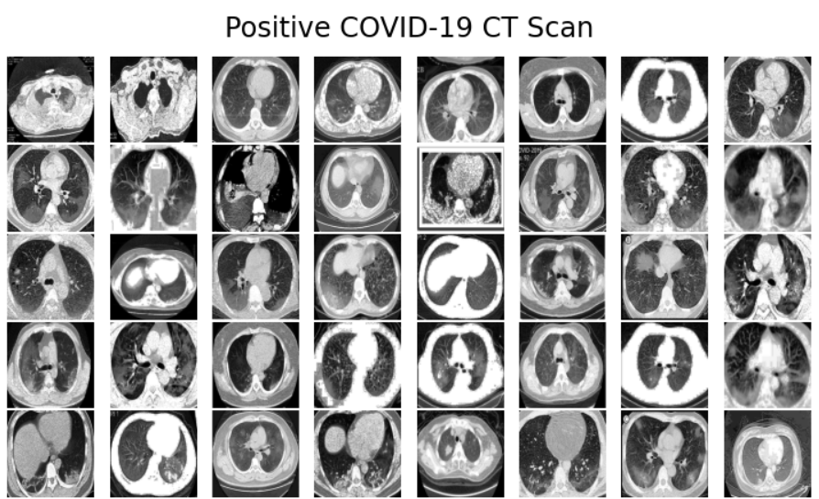
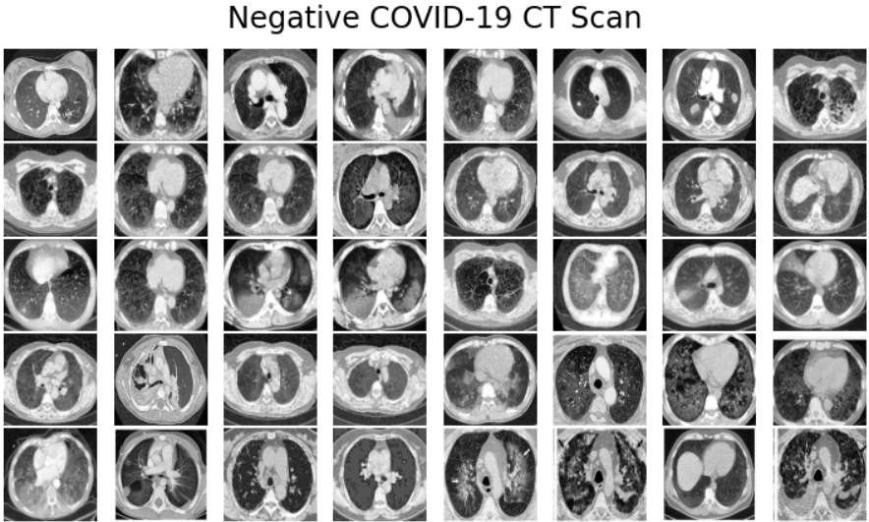
Image before preprocessing
Image after preprocessing
Notes:
這是經過上述四種方法進行前處理後的結果，左邊是前處理前的影像，右邊是處理完後的影像。
可以看到肺部的邊緣輪廓較清晰，圖片顏色也較相近。

Slide 18

IMAGE ANALYIS
Notes:
再來要介紹特徵擷取的部分

Slide 19
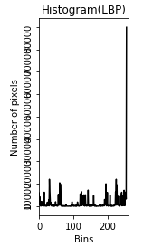
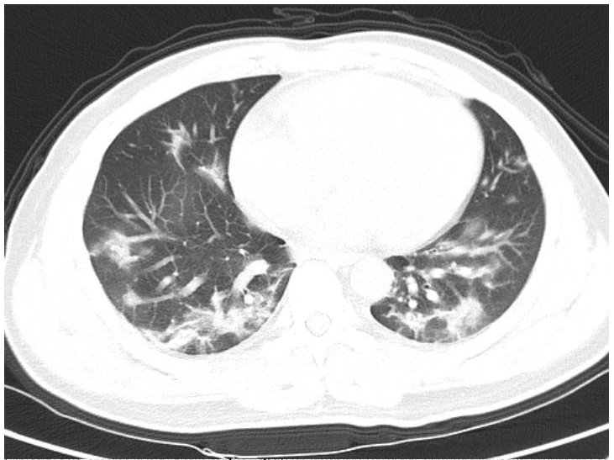
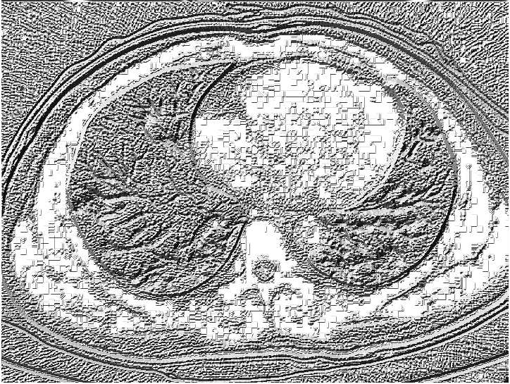
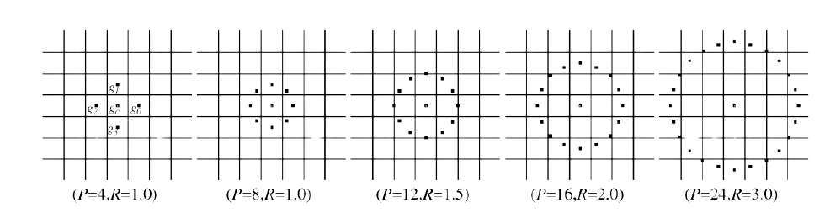
Local binary pattern
The coception is popular from “Multiresolution Gray-Scale and Rotation Invariant Texture Classification with Local Binary Patterns“
“In this paper, we propose a theoretically and computationally simple approach which is robust in terms of grayscale variations and which is shown to discriminate a large range of rotated textures efficiently. “
Original Image
LBP representation image
LBP histogram
Notes:
第一個特徵擷取是局部二值模式，它會對圖像中每個像素的鄰域進行閥值處理來標記，並將結果設為二進制。
實作上我們使用github上的開源程式實作。

Slide 20
Gray-Level Co-occurrence Matrix(GLCM)
Haralick once proposed 14 kinds of statistics calculated based on the gray level co-occurrence matrix: namely: energy, entropy, contrast, uniformity, correlation, variance, sum average, sum variance, sum entropy, difference variance, difference average, difference entropy , Related information measurement and maximum correlation coefficient.
Here we refer to "Medical Image Processing and Deep Learning to Diagnose COVID-19 with CT Images" , and select four statistics as the basis for our analysis: correlation, energy, contrast, and entropy.
Notes:
第二個特徵處理，我們使用灰度共生矩陣。灰度共生矩陣將所有估計值表示成一個矩陣的格式，但由於它資料量較大，故不直接作為區分紋理的特徵，而是基於它構建的一些統計量作為紋理分類特徵。
實作上我們利用灰度共生矩陣計算出相關性、能量、對比度及熵，但因為這些結果都是數值，我們來不及研究如何把這些數值放入模型一起訓練，所以後續的模型沒有加入這個特徵的結果。

Slide 21
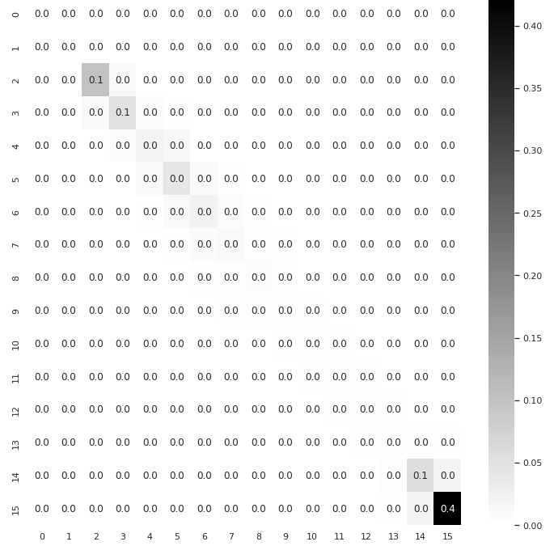
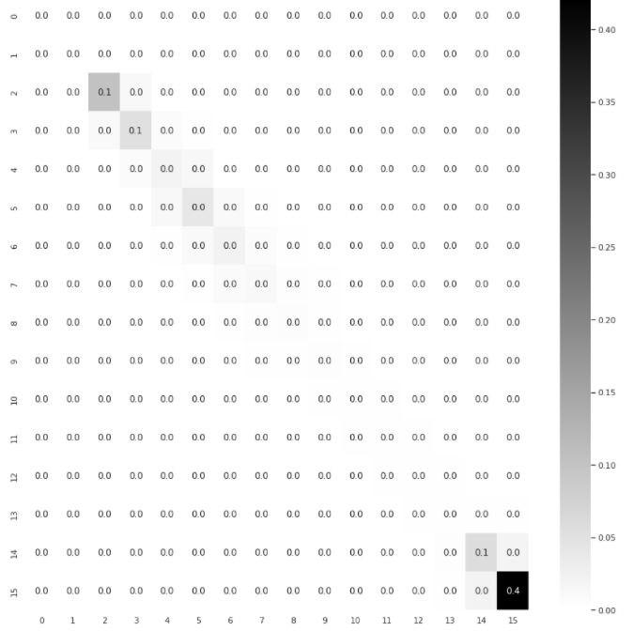
Generate gray level co-occurrence matrix
First determine a maximum gray level number, and find the maximum gray level, then traverse each pixel to count the gray level value to generate a gray level matrix
maximum gray level number=16
maximum gray level number=32
Notes:
這是我們產生的灰度共生矩陣，左邊是最大灰度級數為16的灰度共生矩陣，右邊是最大灰度級數為32的灰度共生矩陣

Slide 22
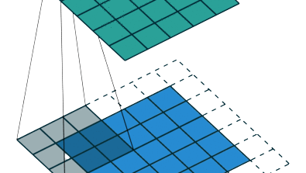
MODEL

Slide 23
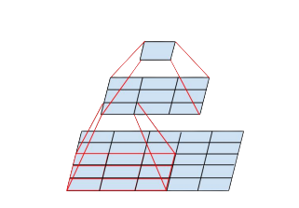
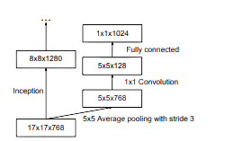
Inception V3
The conception started from ”Rethinking the Inception Architecture for Computer Vision” early with InceptionV2.
Factorizing Convolutions with Large Filter Size
“...with suitable factorization, we can end up with more disentangled parameters and therefore with faster training”
Introducing the notion of auxiliary classifiers to improve the convergence
“argues that auxiliary classifiers promote more stable learning and better convergence. “
Notes:
“由於 Inception 網絡是完全卷積的，每個權重對應於每個激活的一個乘法。 因此，任何計算成本的降低都會導致參數數量的減少。 這意味著通過適當的分解，我們最終可以得到更多解開的參數，因此訓練速度更快。 此外，我們可以使用計算和內存節省來增加我們網絡的濾波器組大小，同時保持我們在單台計算機上訓練每個模型副本的能力”
輔助分類器在訓練早期並沒有改善收斂：在兩個模型達到高精度之前，有和沒有側頭的網絡的訓練進程看起來幾乎相同。 接近訓練結束時，有輔助分支的網絡開始超過沒有任何輔助分支的網絡的準確率，並達到一個稍高的平台。

Slide 24
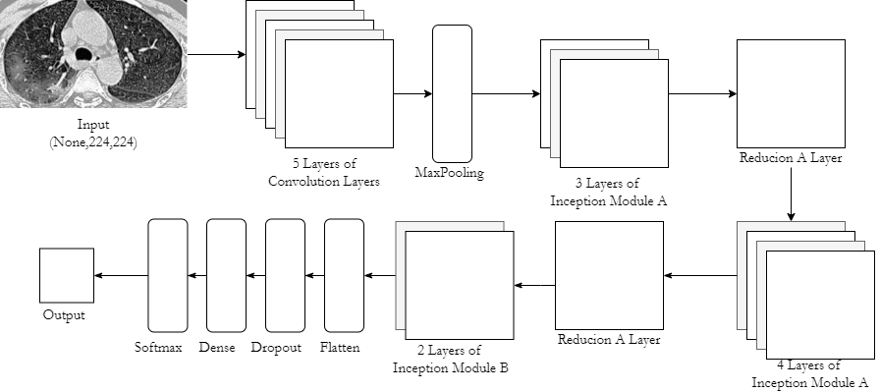
Architecture

Slide 25
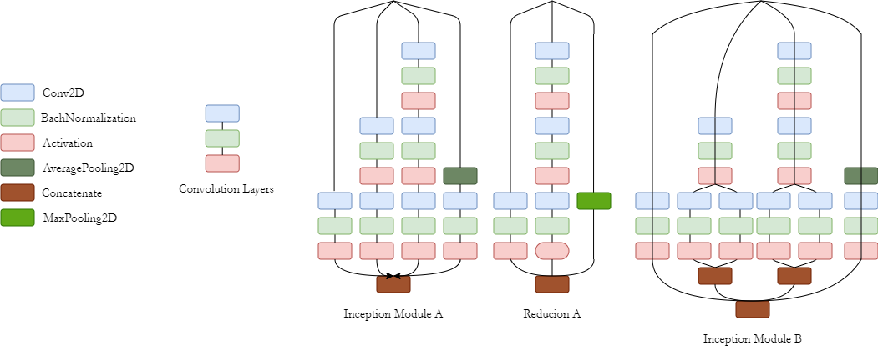

Slide 26
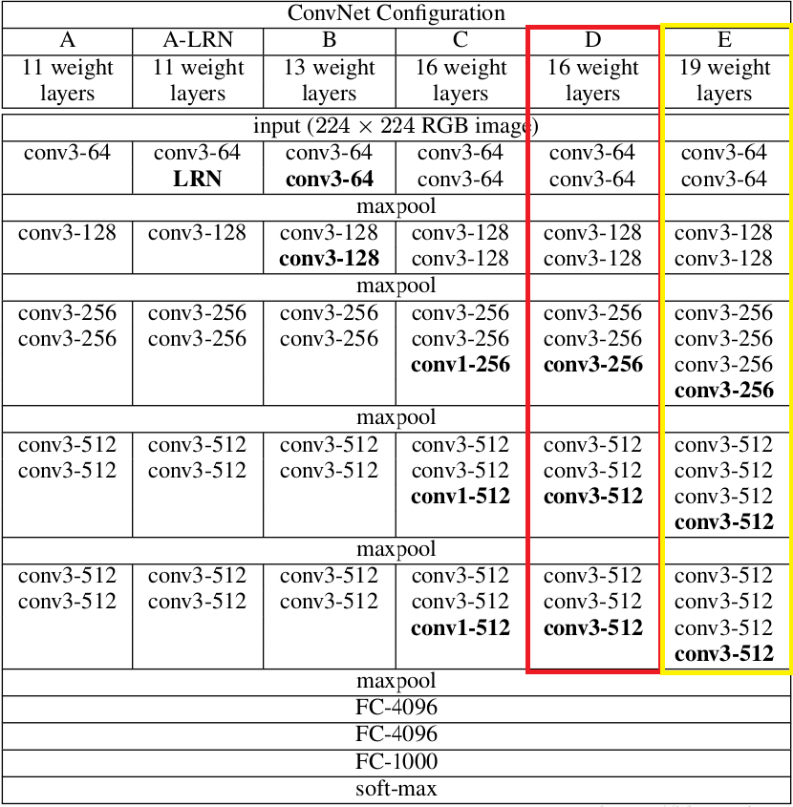
VGG-19
According to “VERY DEEP CONVOLUTIONAL NETWORKS FOR LARGE-SCALE IMAGE RECOGNITION”:
VGG19 contains 19 hidden layers (16 convolutional layers and 3 fully connected layers).
Its advantage lies in its simple structure, but along with its extremely deep characteristics, it will cause a large number of parameters and the disadvantage of taking up a large space.

Slide 27
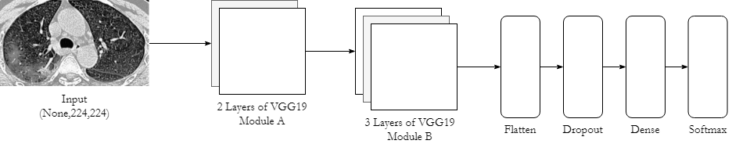
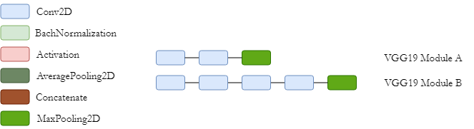
Architecture

Slide 28
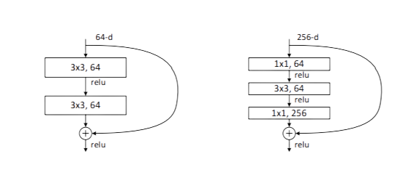
ResNet50
According to “Deep Residual Learning for Image Recognition “
The existence of ResNet simply makes deep networks easier to train, and also opens the era of various ultra-deep networks.
Bottleneck Architectures
“...50-layer ResNet: We replace each 2-layer block in the 34-layer net with this 3-layer bottleneck block, resulting in a 50-layer ResNet .”

Slide 29
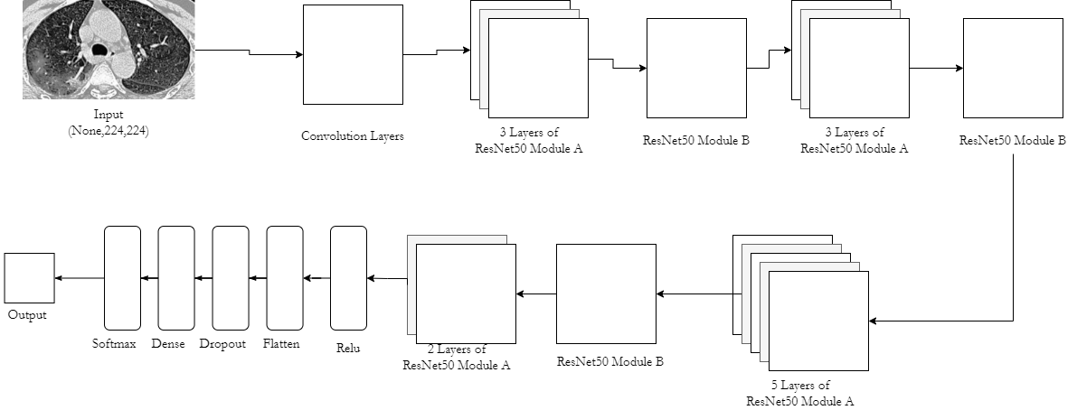
Architecture

Slide 30
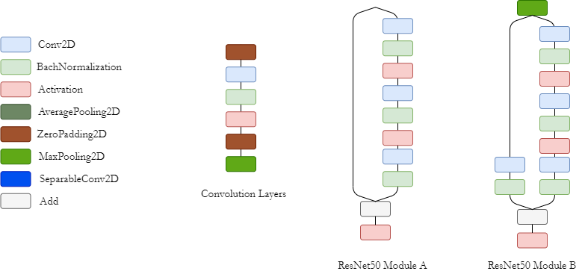

Slide 31
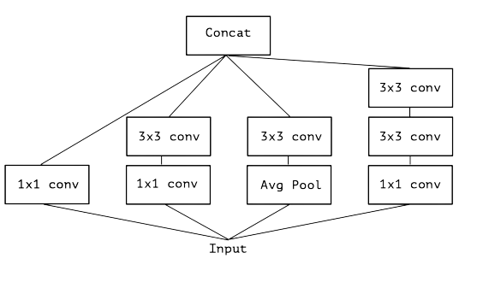
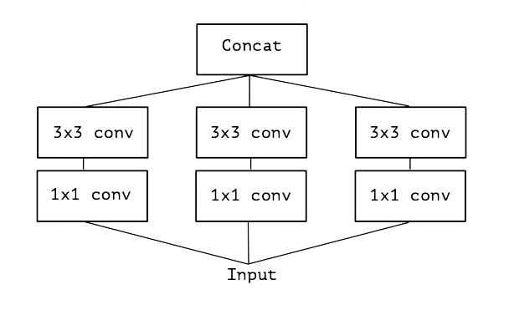
Xception
In "Xception: Deep Learning with Depthwise Separable Convolutions" said:“An “extreme” version of an Inception module”
The core of Xception is “use a 1x1 convolution to map cross-channel correlations, and would then separately map the spatial correlations of every output channel.“
which means “Separate space from channel”
A canonical Inception module (Inception V3)
A simplified Inception module

Slide 32
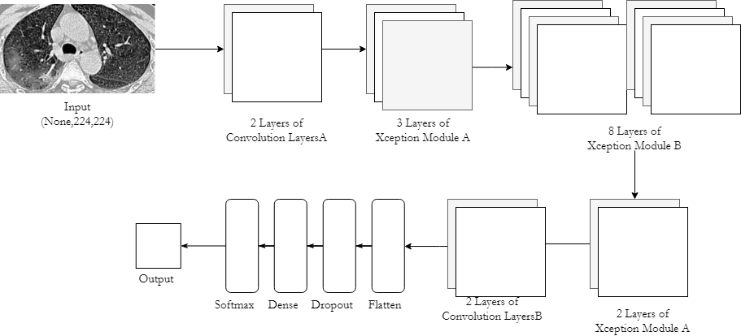
Architecture

Slide 33
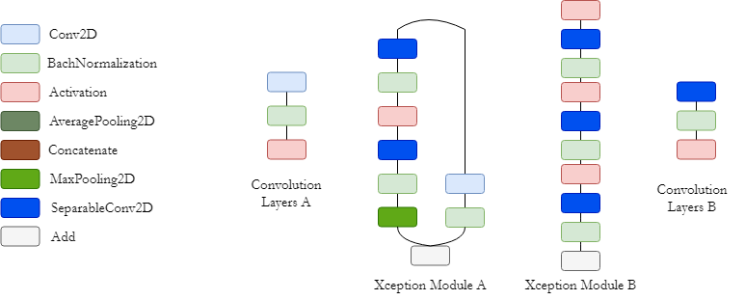

Slide 34
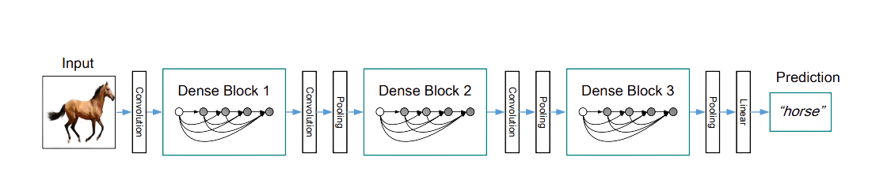
DenseNet169
According to “Densely Connected Convolutional Networks”,Each layer takes all the previous feature maps as input, so that the problem of gradient disappearance can be alleviated.

Slide 35

RESULT

Slide 36
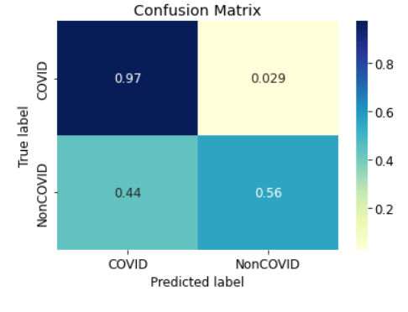
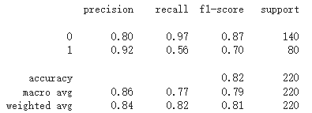
InceptionV3
Confusion Matrix
Classification Report

Slide 37
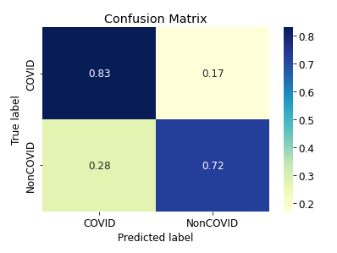
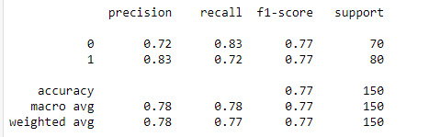
VGG19
Confusion Matrix
Classification Report

Slide 38
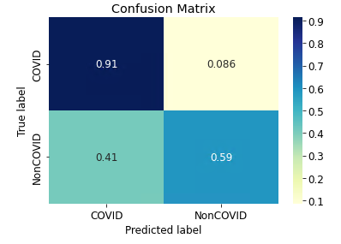
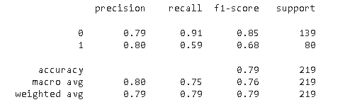
ResNet50
Confusion Matrix
Classification Report

Slide 39
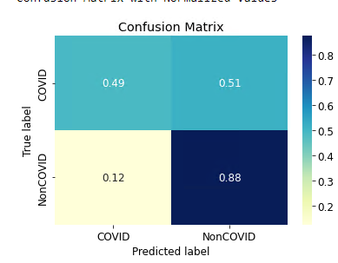
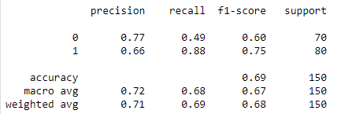
Xception
Confusion Matrix
Classification Report

Slide 40

CONCLUSION

Slide 41
Table
Method |  | precision | recall | f1-score
InceptionV3 | macro avg | 0.86 | 0.77 | 0.79
 | weighted avg | 0.84 | 0.82 | 0.81
VGG19 | macro avg | 0.78 | 0.78 | 0.77
 | weighted avg | 0.78 | 0.77 | 0.77
ResNet50 | macro avg | 0.80 | 0.75 | 0.76
 | weighted avg | 0.79 | 0.79 | 0.79
Xception | macro avg | 0.72 | 0.68 | 0.67
 | weighted avg | 0.71 | 0.69 | 0.68
DenseNet169 |  | 0.6744 | 1 | 0.7627

Slide 42
Thanks for your Attention

